Slide 1
Heavy Vehicle Testbed
Created by: Aniruddha Malkar
Database management systems

Slide 2
Why we need a real time physical testbed than a simulator?
Cyber physical systems are complex systems that controls physical parameters in system/ plant.
For comprehensive monitor & control they require complex interaction between each other
Simulator don’t produce accurate results as the real time operation and result are hard to predict.
To test the heavy vehicle security accurately we need a accurate real time cyber physical testbed.

Slide 3
Why we need an Open source testbed?
The Deter lab project has changed the way of looking towards testbed
Deter lab is a open source electronic testbed allow users to test computer/internet attacks and allow users to test their solution
Deter run all the experiments simultaneously into testbed
But the Deter don’t have any facility to test heavy vehicle security
The heavy vehicle security is getting more sensitive and vulnerable now. There is a high requirement of Open source cyber physical testbed that allows users to parallelly access the different models of heavy vehicles.

Slide 4
What is the problem of creating Deter like testbed ?
Problem 1:
The Deter lab allow users to access the testbed through SSH like of the computer node inside the testbed created for the user.
But such access cant be provided in Heavy Vehicle testbed due to two reasons: 1) The node inside the testbeds are ECUs and ECUs cant handle normal commuting operations. 2) Even getting such SSH access wont provide users a comprehensive analysis.
The Heavy vehicle testbed is a cyber physical testbed requires extraordinary security.
We can allow users to access the testbed from their computer. It may harm users’, testbed and vehicle manufacturers security.

Slide 5
What is the problem of creating Deter like testbed ?
Problem 2:
The Heavy vehicle testbed is a cyber physical testbed requires extraordinary security.

Slide 6
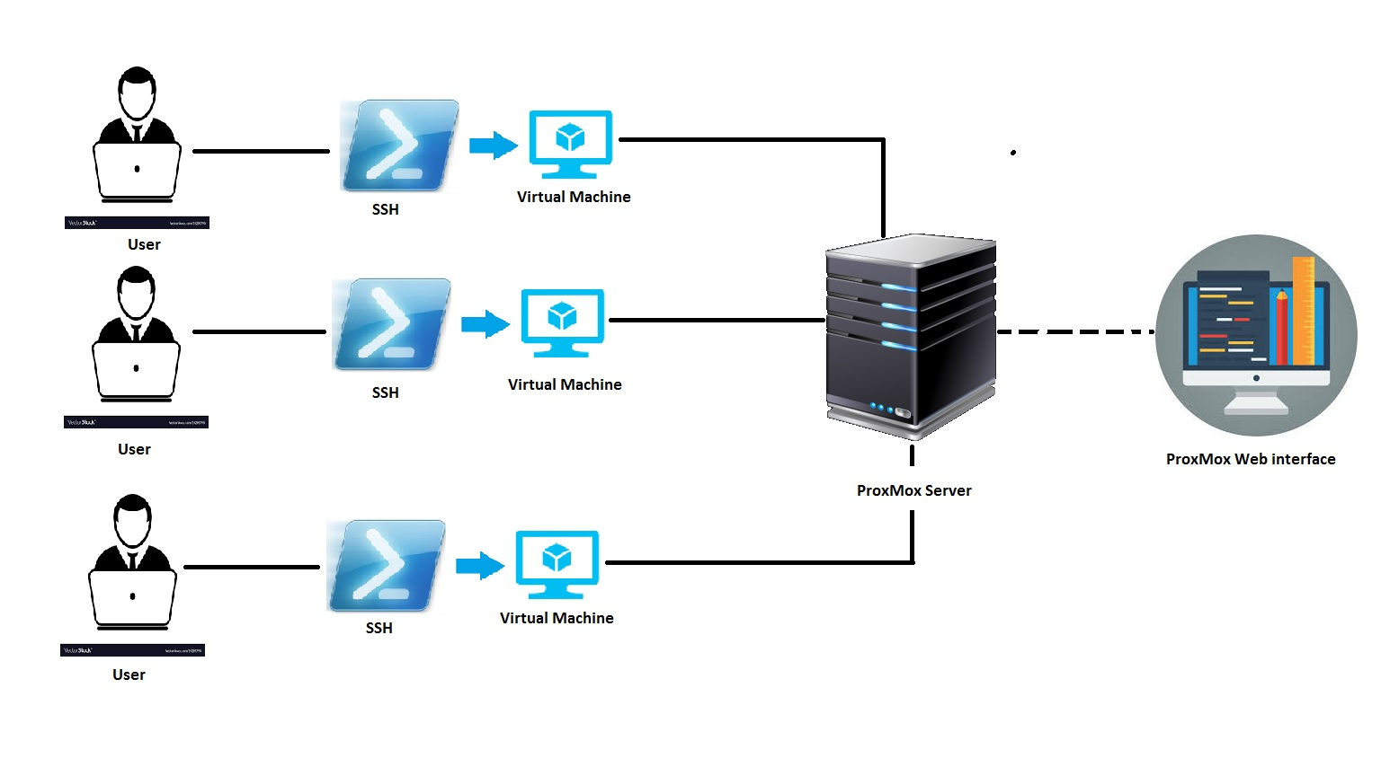
How we solved first problem?
Virtualization environment has solved many problems including this.
The Virtualization environment allow us to create the VM, deploy VM.
We connect the physical testbed with the virtualization environment. Where we provide access to the users through the VM that is directly connected with the physical testbed.
Virtualization solves two problems:
1) Parallel access to the testbed
2) Security issue in problem 1

Slide 7

How I set virtualization environment?
ProxMox is an open source environment that allowed me to create virtualization environment.
We installed customized Ubuntu OS for VMs and provided access through the VM.
For better availability I used RAID 50 technique that sustains the disk failures.

Slide 8
What else?
We need a communication socket that will send the converted CAN packets (in TCP form) to VM that allows users to monitor the CAN network.
We need another socket that will transfer the converted CAN packets (in TCP form) from VM to testbed to allow user to implement the attack.
Problem:
Need two bidirectional continuous sockets that consumes lot of host resources causes translating program to loose some CAN packet.
Solution:
Used multiprocessing library of the Python that smartly uses the resources of the hosts and prevent loosing CAN packets.

Slide 9
Future Work
Solving problem 2 using the XACML an attribute based access control.

Slide 10




Thank you for listening to me…

